Slide 1
Roulette Lab - A Casino App Powered by Data Science
Made by Simões Barbosa Ricardo, Huber Pablo, Bortolotti Luca, Wieland Oscar

Slide 2
Introduction
Roulette Lab is an interactive casino shiny app that brings the excitement of roulette to the digital world. It covers the features and functionality of the app, the background and development process, and its potential for integrating entertainment and data science.

Slide 3
Why a casino app ?
We found our inspiration from the various game shiny apps examples on https://shiny.posit.co/r/gallery/
We also liked working on the r games during the previous homeworks
Microeconomics 2 introduced us to Game Theory and we found that Data science allowed us to merge both topics by investigating strategies

Slide 4
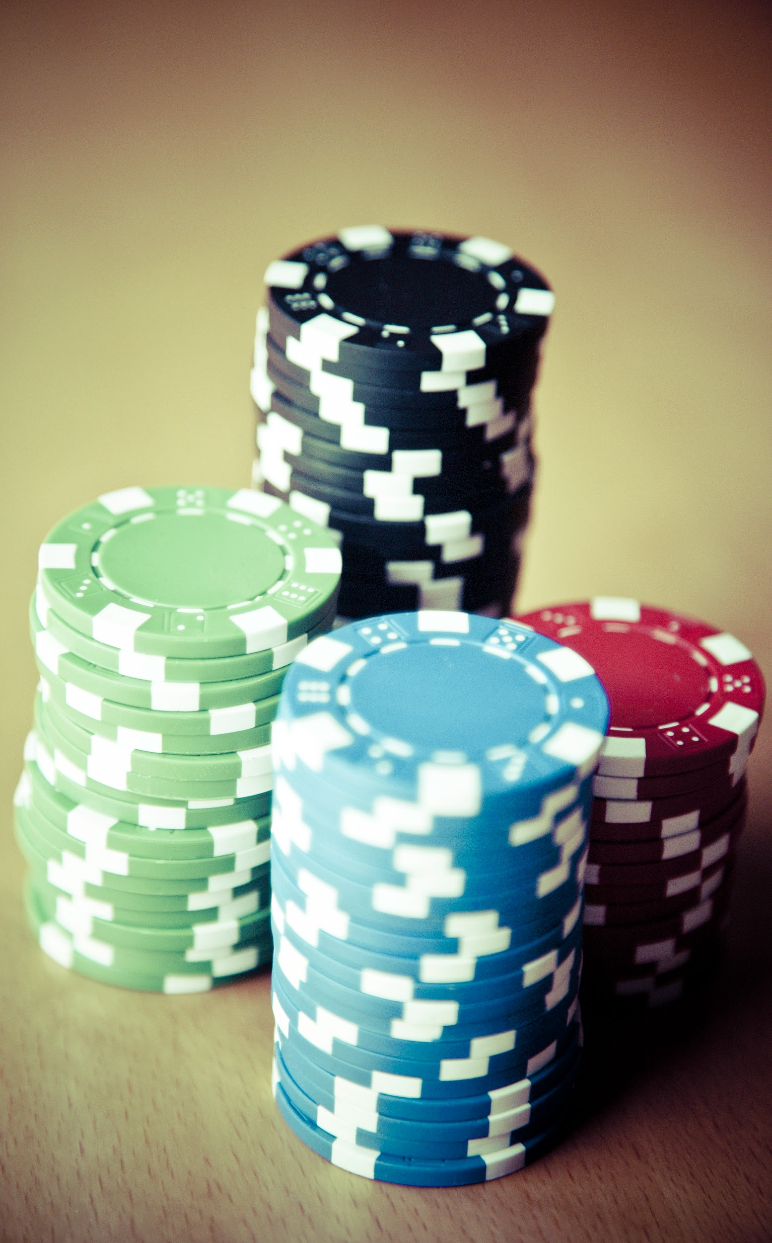
Introduction to Roulette Lab
An innovative casino app designed to bring the thrill and excitement of roulette to the digital world.
Developed as a part of a data science group project.
Provides users with an immersive experience including playing roulette and simulating multiple roulette strategies.

Slide 5
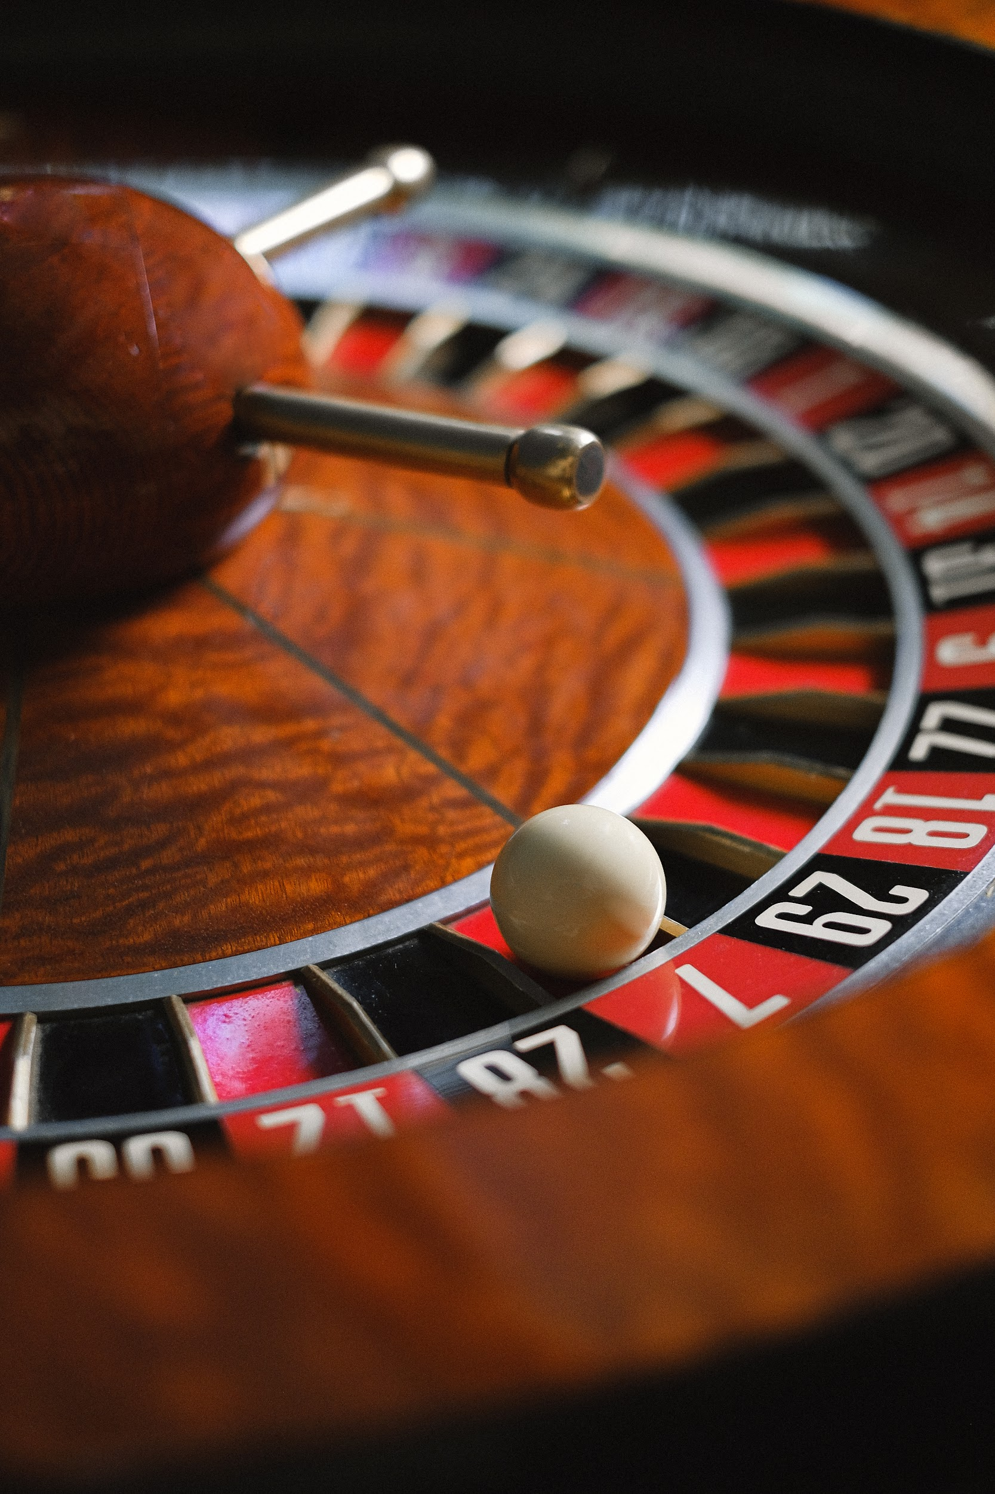
Realistic Roulette Gameplay
Provides an authentic roulette experience with a visually appealing roulette wheel, accurate ball movements and dynamic sound effects
Ensures an immersive gaming experience including all the bet possibilities of a real roulette game
Includes a balance and a chip color selection system

Slide 6

Simulated Strategies
Users can experiment with various roulette strategies, both popular and custom-made, to examine their effectiveness in different scenarios.
From the Martingale system to the Fibonacci sequence, Roulette Lab allows users to test and evaluate these strategies in a risk-free environment.

Slide 7

Development of Roulette Lab
Initiated as a data science group project.
The project team consisted of 4 students
Began with detailed analysis of the roulette game and already existing shiny apps.
Leveraged programming languages like R shiny, CSS and HTML to build the frontend and backend components of the app.

Slide 8

Difficulties
Starting from an already finished project was a challenging experience.
LaTeX gave us difficulties in showing the mathematical writing.
Uploading this kind of package on cran seemed almost impossible
Handling CSS inside shiny was not always easy
Rstudio is constantly crashing

Slide 9
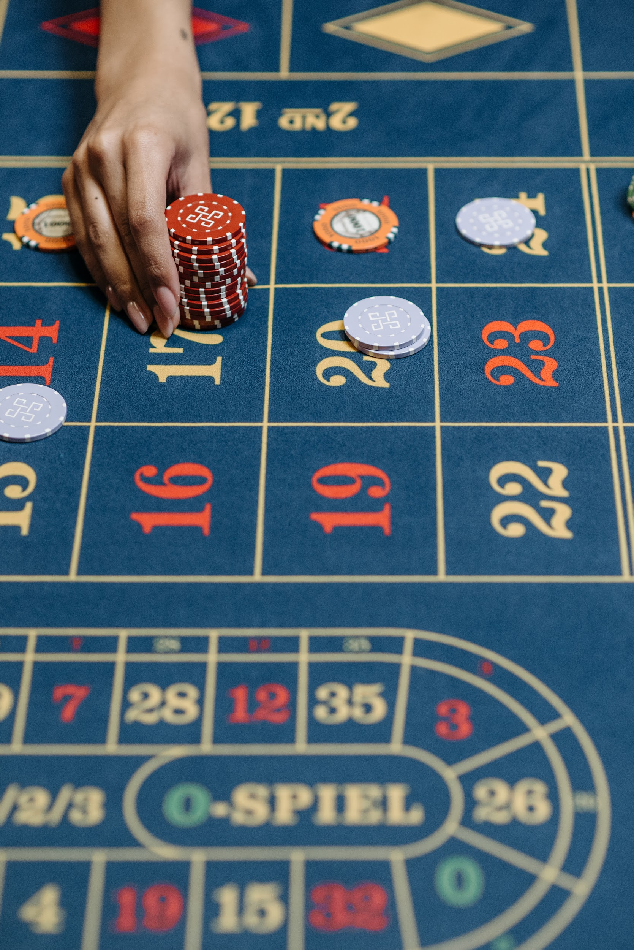
Conclusion
Roulette Lab stands as a fusion of entertainment and data science.
Offers users a thrilling experience while serving as a platform for exploring and analyzing the complexities of roulette.
Empowers users to deepen their understanding of the game and ultimately enhance their decision-making skills.
Showcases the potential of data science applications beyond conventional domains.

Slide 10
Thank you. Please feel free to ask any questions.

